Slide 1



Sales Dashboard
View in Power BI
Last data refresh:
21/04/2025 15:50:08 UTC
Downloaded at:
21/04/2025 16:08:23 UTC

Slide 2
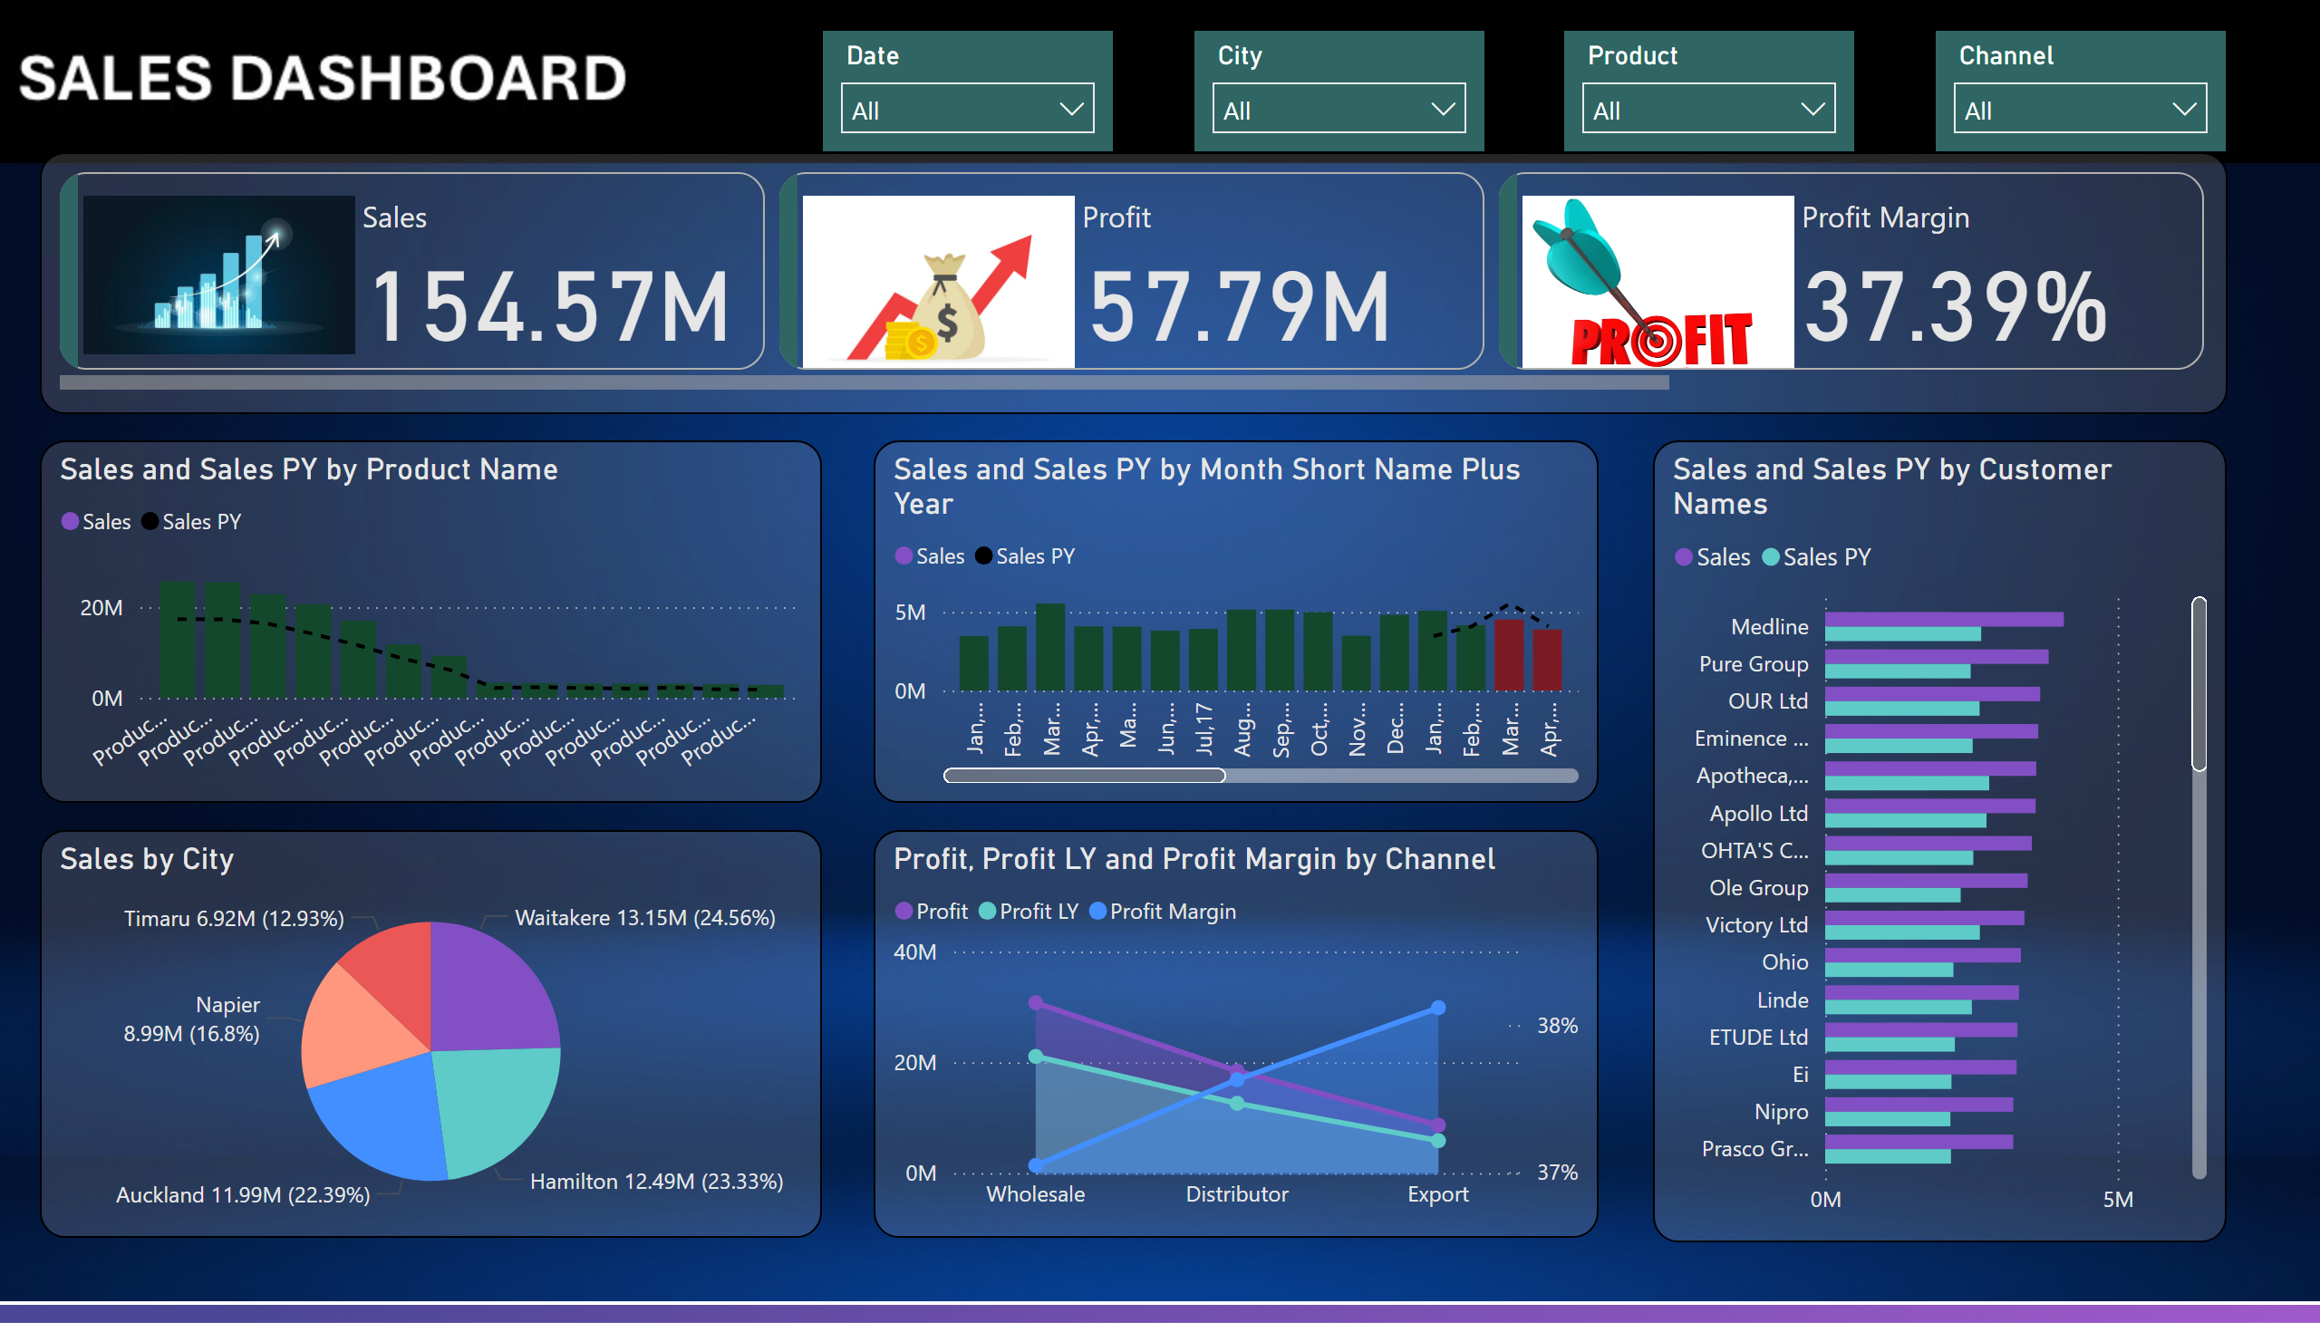
Sales Dashboard
Notes:
slicer
No alt text provided
slicer
No alt text provided
slicer
No alt text provided
slicer
No alt text provided
lineClusteredColumnComboChart
No alt text provided
lineClusteredColumnComboChart
No alt text provided
pieChart
No alt text provided
areaChart
No alt text provided
clusteredBarChart
No alt text provided
cardVisual
No alt text provided

